Slide 1

Business Intelligence: A Managerial Perspective on Analytics (3rd Edition)
Chapter 2:
Data Warehousing

Slide 2
What is a Data Warehouse?
A physical repository where relational data are specially organized to provide enterprise-wide, cleansed data in a standardized format
“The data warehouse is a collection of integrated, subject-oriented databases designed to support DSS functions, where each unit of data is non-volatile and relevant to some moment in time”

Slide 3
A Historical Perspective to Data Warehousing

Slide 4
Characteristics of DWs
Subject oriented
Integrated
Time-variant (time series)
Nonvolatile
Summarized
Not normalized
Metadata
Web based, relational/multi-dimensional
Client/server, real-time/right-time/active …

Slide 5
Data Mart
A departmental small-scale “DW” that stores only limited/relevant data
Dependent data mart
A subset that is created directly from a data warehouse
Independent data mart
A small data warehouse designed for a strategic business unit or a department

Slide 6
Other DW Components
Operational data stores (ODS)
A type of database often used as an interim area for a data warehouse
Oper marts - an operational data mart.
Enterprise data warehouse (EDW)
A data warehouse for the enterprise.
Metadata
Data about data. In a data warehouse, metadata describe the contents of a data warehouse and the manner of its acquisition and use

Slide 7
A Generic DW Framework

Slide 8
DW Architecture
Three-tier architecture
Data acquisition software (back-end)
The data warehouse that contains the data & software
Client (front-end) software that allows users to access and analyze data from the warehouse
Two-tier architecture
First two tiers in three-tier architecture is combined into one
… sometimes there is only one tier?

Slide 9
DW Architectures
3-tier
architecture
2-tier
architecture
1-tier
Architecture
?

Slide 10
Data Warehousing Architectures
Issues to consider when deciding which architecture to use:
Which database management system (DBMS) should be used?
Will parallel processing and/or partitioning be used?
Will data migration tools be used to load the data warehouse?
What tools will be used to support data retrieval and analysis?

Slide 11
A Web-Based DW Architecture

Slide 12
Alternative DW Architectures

Slide 13
Alternative DW Architectures
Each architecture has advantages and disadvantages!
Which architecture is the best?

Slide 14
Ten factors that potentially affect the architecture selection decision
Information interdependence between organizational units
Upper management’s information needs
Urgency of need for a data warehouse
Nature of end-user tasks
Constraints on resources
Strategic view of the data warehouse prior to implementation
Compatibility with existing systems
Perceived ability of the in-house IT staff
Technical issues
Social/political factors

Slide 15
Data Integration and the Extraction, Transformation, and Load (ETL) Process
ETL = Extract Transform Load
Data integration
Integration that comprises three major processes: data access, data federation, and change capture.
Enterprise application integration (EAI)
A technology that provides a vehicle for pushing data from source systems into a data warehouse
Enterprise information integration (EII)
An evolving tool space that promises real-time data integration from a variety of sources, such as relational or multidimensional databases, Web services, etc.

Slide 16
Data Integration and the Extraction, Transformation, and Load (ETL) Process

Slide 17
ETL (Extract, Transform, Load)
Issues affecting the purchase of an ETL tool
Data transformation tools are expensive
Data transformation tools may have a long learning curve
Important criteria in selecting an ETL tool
Ability to read from and write to an unlimited number of data sources/architectures
Automatic capturing and delivery of metadata
A history of conforming to open standards
An easy-to-use interface for the developer and the functional user

Slide 18
Data Warehouse Development
Data warehouse development approaches
Inmon Model: EDW approach (top-down)
Kimball Model: Data mart approach (bottom-up)
Which model is best?
One alternative is the hosted warehouse

Slide 19
Additional Data Warehouse Considerations Hosted Data Warehouses
Benefits:
Requires minimal investment in infrastructure
Frees up capacity on in-house systems
Frees up cash flow
Makes powerful solutions affordable
Enables solutions that provide for growth
Offers better quality equipment and software
Provides faster connections

Slide 20
Representation of Data in DW
Dimensional Modeling
A retrieval-based system that supports high-volume query access
Star schema
The most commonly used and the simplest style of dimensional modeling
Contain a fact table surrounded by and connected to several dimension tables
Snowflakes schema
An extension of star schema where the diagram resembles a snowflake in shape

Slide 21
Multidimensionality
The ability to organize, present, and analyze data by several dimensions, such as sales by region, by product, by salesperson, and by time (four dimensions)
Multidimensional presentation
Dimensions: products, salespeople, market segments, business units, geographical locations, distribution channels, country, or industry
Measures: money, sales volume, head count, inventory profit, actual versus forecast
Time: daily, weekly, monthly, quarterly, or yearly

Slide 22
Star versus Snowflake Schema

Slide 23
Analysis of Data in DW
OLTP vs. OLAP…
OLTP (online transaction processing)
Capturing and storing data from ERP, CRM, POS, …
The main focus is on efficiency of routine tasks
OLAP (Online analytical processing)
Converting data into information for decision support
Data cubes, drill-down / rollup, slice & dice, …
Requesting ad hoc reports
Conducting statistical and other analyses
Developing multimedia-based applications

Slide 24
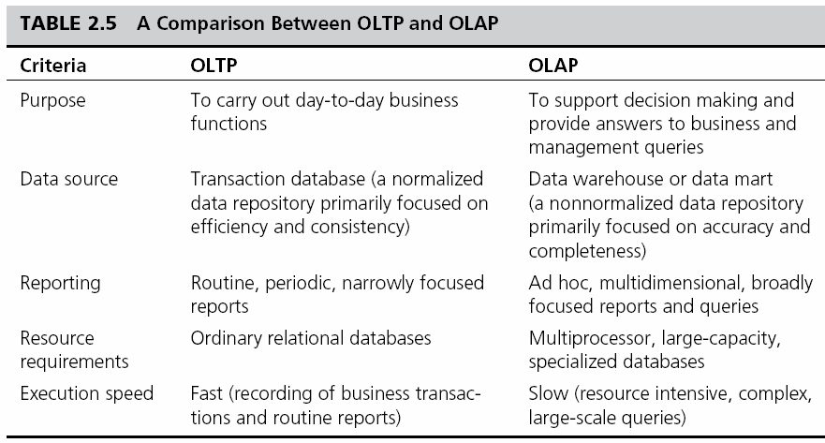
OLAP vs. OLTP

Slide 25
OLAP Operations
Slice - a subset of a multidimensional array
Dice - a slice on more than two dimensions
Drill Down/Up - navigating among levels of data ranging from the most summarized (up) to the most detailed (down)
Roll Up - computing all of the data relationships for one or more dimensions
Pivot - used to change the dimensional orientation of a report or an ad hoc query-page display

Slide 26
OLAP
Slicing Operations on a Simple Three-Dimensional
Data Cube

Slide 27
Variations of OLAP
Multidimensional OLAP (MOLAP)
OLAP implemented via a specialized multidimensional database (or data store) that summarizes transactions into multidimensional views ahead of time
Relational OLAP (ROLAP)
The implementation of an OLAP database on top of an existing relational database
Database OLAP and Web OLAP (DOLAP and WOLAP); Desktop OLAP,…

Slide 28
DW Implementation Issues
Identification of data sources and governance
Data quality planning, data model design
ETL tool selection
Establishment of service-level agreements
Data transport, data conversion
Reconciliation process
End-user support
Political issues

Slide 29
Successful DW Implementation Things to Avoid
Starting with the wrong sponsorship chain
Setting expectations that you cannot meet
Engaging in politically naive behavior
Loading the data warehouse with information just because it is available
Believing that data warehousing database design is the same as transactional database design
Choosing a data warehouse manager who is technology oriented rather than user oriented

Slide 30
Failure Factors in DW Projects
Lack of executive sponsorship
Unclear business objectives
Cultural issues being ignored
Change management
Unrealistic expectations
Inappropriate architecture
Low data quality / missing information
Loading data just because it is available

Slide 31
Massive DW and Scalability
Scalability
The main issues pertaining to scalability:
The amount of data in the warehouse
How quickly the warehouse is expected to grow
The number of concurrent users
The complexity of user queries
Good scalability means that queries and other data-access functions will grow linearly with the size of the warehouse

Slide 32
Real-Time/Active DW/BI
Enabling real-time data updates for real-time analysis and real-time decision making is growing rapidly
Push vs. Pull (of data)
Concerns about real-time BI
Not all data should be updated continuously
Mismatch of reports generated minutes apart
May be cost prohibitive
May also be unfeasible

Slide 33
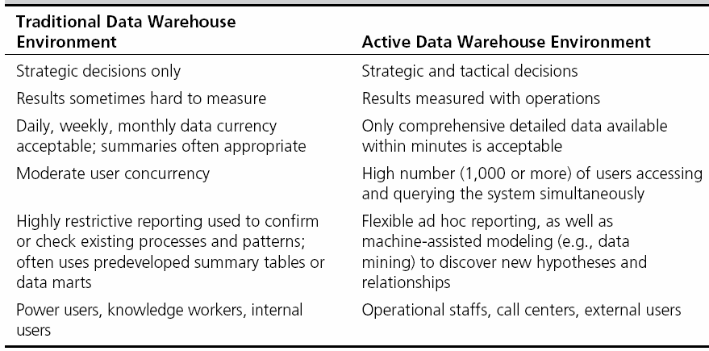
Traditional versus Active DW

Slide 34
DW Administration and Security
Data warehouse administrator (DWA)
DWA should…
have the knowledge of high-performance software, hardware and networking technologies
possess solid business knowledge and insight
be familiar with the decision-making processes so as to suitably design/maintain the data warehouse structure
possess excellent communications skills
Security and privacy is a pressing issue in DW
Safeguarding the most valuable assets
Government regulations
Must be explicitly planned and executed

Slide 35
The Future of DW
Sourcing…
Web, social media, and Big Data
Open source software
SaaS (software as a service)
Cloud computing
Infrastructure…
Real-time DW
Data warehouse appliances
Data management practices/technologies
In-database & In-memory processing New DBMS
Advanced analytics

